Slide 1
Gas Price Forecaster

Slide 2
Goals & motivation
Analyze trends in gas price fluctuations
Successfully advise users on when it is the right time to fill up the tank (or just get enough to get through the week)

Slide 3
Data
Gas price average across 14 different gas stations in the campus area
WTI (Crude oil price)
Separate Texas weekly gas price average and WTI price ranging from 2000-2019.

Slide 4

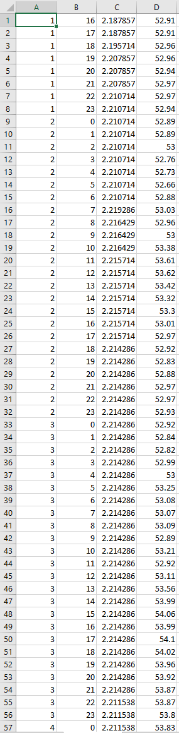

Slide 5
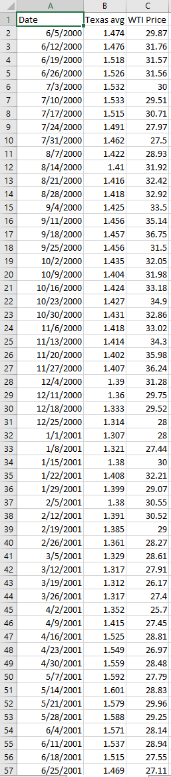

Slide 6
Method
Researching several possible methods:
Linear Regression
Autoregression
Time series forecasting using recurrent neural networks

Slide 7
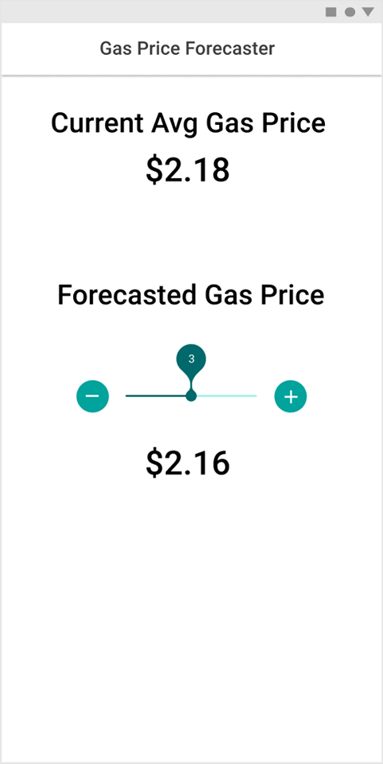
APP Goal

